Slide 1
Winequality Workshop

Slide 2



Who’s here to help?
<your name here>
<your name here>
<your title here>
<your title here>

Slide 3
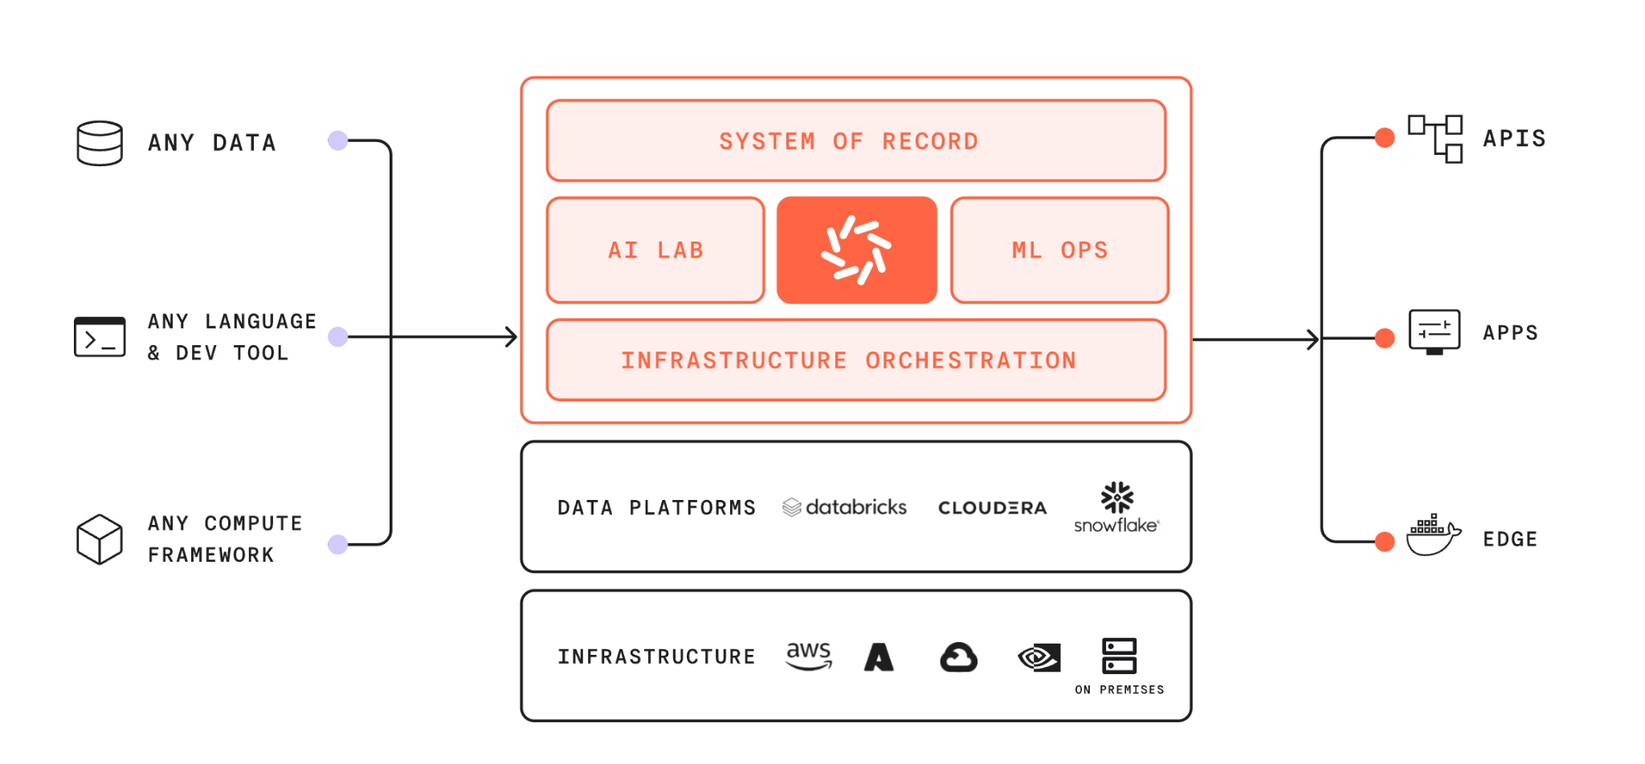
What is Domino?
Notes:
If you went to our website and looked up what Domino is, you’d see something like this. Good marketing visual, but it probably doesn’t tell you much about how it can make your life easier.

Slide 4
What is Domino?
Data scientists need to | It must be easier to | What can Domino do?
Build models | Securing access to necessary data Provisioning sufficient compute resources Configuring the required environment | Projects in Domino deliver secure data access, on-demand compute, and managed environments.
Deploy models | Managing versioned models Deploying models in stakeholder-appropriate environments | Once models are built, Domino supports four methods to deploy them.
Monitor models | Models require tailored monitoring Re-training deployed models | Domino enables monitoring and remediation of your models, all through a single-pane-of-glass.
Collaborate | Forking and merging model versions Preserving files and knowledge during team transitions | Domino is architected for collaboration: seamlessly share assets, track team progress, and fully reproduce work.
Notes:
I’m a data scientist. So I think about what I need to do as a data scientist. What are my jobs to be done? … When I do these things, certain parts are easy. Like, when I build a model, I’m good on the machine learning part — picking which model to build, or which features to engineer. That’s actually the fun part for me. But, some parts of the model building process have some friction. When I join a new team or get assigned to a new project, getting secure access to data often takes a long time. Or provisioning compute resources for big jobs, that can be time-consuming or complicated. (and so on…)
(We know you, because we are you!)

Slide 5




Workshop Agenda
Prepare
Project &
Data
Develop
Model
Deploy
Model
Create Project
Prepare & Evaluate Model
Deploy & Collaborate
Set up project
Add collaborators
Define project goals
Set up data source
Customize compute environment
Leverage preferred IDEs
Distributed compute frameworks
Run and track experiments
Run Jobs
Model API
Web application
Share and Collaborate
MLOps and the Data Science Project Lifecycle

Slide 6
Workshop Goals
Understanding Mlops with Domino
Get a brief overview of typical enterprise data science platform.
Learn how Mlops improves productivity
Walk through best practices - simulating a data science project workflow.
Validate Mlops to meet your needs
Guided hands-on labs and learn best practices along the way.

Slide 7
By the end of this training, you will be able to:
Access compute
and environments
with Domino Projects.
Write code and
build models
with Domino Workspaces.
Deploy models
to production
with Jobs and publishing an endpoint and app.
Understand Domino programmatically
with the command line, Domino API, and Domino’s Python/R packages.

Slide 8
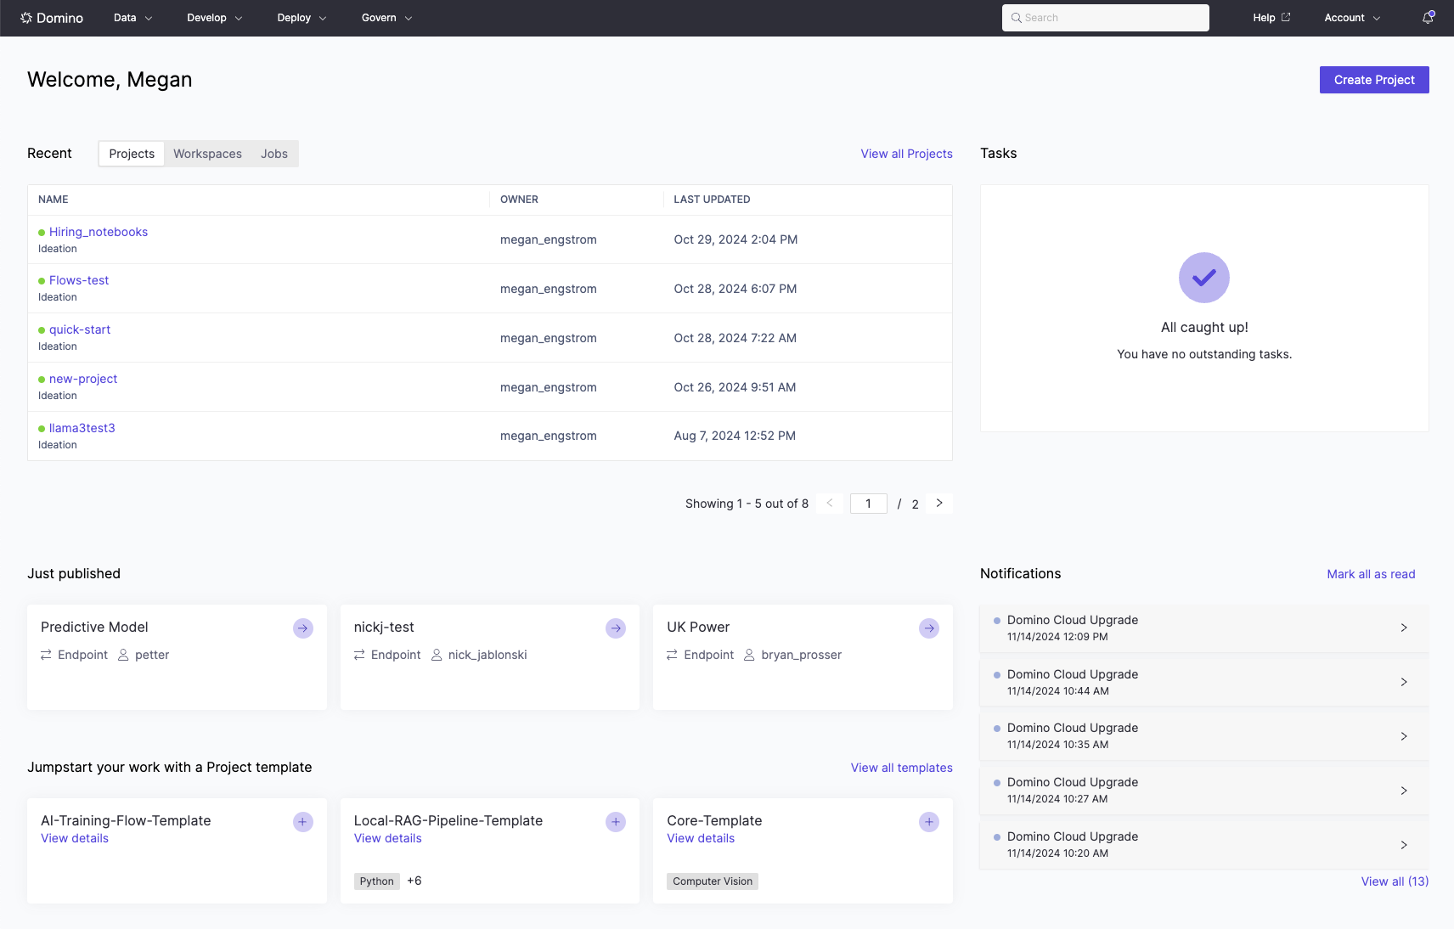
You’ll use Domino a lot today.
Let’s make sure you have access.
Go to <your url here> This is the Domino instance we’ll use for training.
Sign in.
When your screen looks like this, you’re good to go!

Slide 9
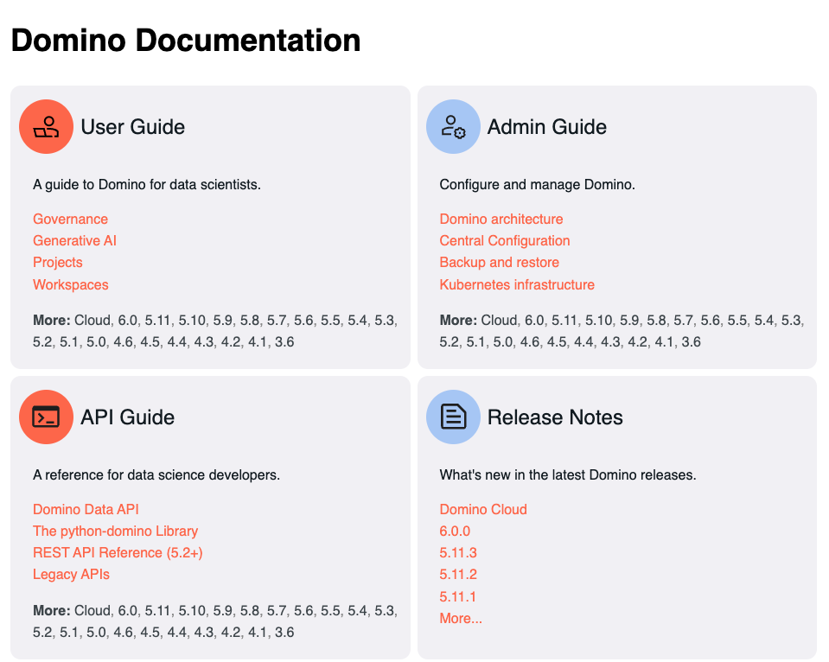
Our Docs are split by Users and Admins.
Access our documentation at https://docs.dominodatalab.com/

Slide 10
Pre-setup
Add a personal access token

Slide 11
Pre-setup
Configure your Personal Access Token (PAT)
Domino supports all major git iternations including but not limited to GitHub, GitLab, Bitbucket and on-prem git.
Configure your PAT using the following link. Your teacher will paste this in the chat.
Winequality Workshop - pre-setup
Notes:
Projects do all of these things. To run code, Projects have to have hardware/software. To store files, Projects have to have storage space. To publish assets or track team goals, Projects have to enable collaboration. As the User, you have control over all of these things in your Project!
So if you need certain software or certain storage space, you control it — subject to your company policies, enforced by the Admin.

Slide 12
Prepare Projects & Data
Add goals, collaborators, and data sources

Slide 13
Best Practices: Project Organization
Projects are Domino’s primary organizational unit.
All code must be centralized on one platform.
Projects must be automatically tracked and versioned.
Projects must support seamless collaboration.
Data sources must be governed, easy to add, and shared across the platform.
Project stages and goals must be easily visible to managers.
Notes:
Projects do all of these things. To run code, Projects have to have hardware/software. To store files, Projects have to have storage space. To publish assets or track team goals, Projects have to enable collaboration. As the User, you have control over all of these things in your Project!
So if you need certain software or certain storage space, you control it — subject to your company policies, enforced by the Admin.

Slide 14
Work in Domino happens in Projects.
Projects are the main organizational unit in Domino.
A Project is where you:
run code,
store files,
publish assets,
track progress via tasks & subtasks
and a lot more.
Projects contain hardware and software!
Projects contain storage space!
Projects enable collaboration!
As the User, you control
all of this in your Project!
Notes:
Projects do all of these things. To run code, Projects have to have hardware/software. To store files, Projects have to have storage space. To publish assets or track team goals, Projects have to enable collaboration. As the User, you have control over all of these things in your Project!
So if you need certain software or certain storage space, you control it — subject to your company policies, enforced by the Admin.

Slide 15
You control all of these things via your Project’s settings.
Settings are unique to each Project; changes to one Project do not affect others.
You control your Project’s settings and can customize capabilities to meet your needs.
Admins can adjust limits to ensure Projects comply with organizational policies.
To change your Project’s settings, click Settings in the bottom-left corner.

Slide 16
Set the most important settings now; you can update them later.
By default, your Project inherits your organization’s recommended settings. You can manually adjust:
Hardware Tier: Select the CPU/GPU resources you need.
Compute Environments: Choose the software you need.
Volume Size: Set the storage space you need.
Collaborators: Manage who has access to your Project.

Slide 17
Lab Use Case: Wine Quality
Project Goal
Predict the likely quality of a bottle of wine from a messy dataset and share results with business stakeholders.
Data Set
Attributes describing red and white wines, stored in an AWS S3 bucket.
Workshop Use
Use this model throughout the workshop to simulate a typical data science project lifecycle.

Slide 18
Before Section One
Quick Walkthrough with Q&A

Slide 19
Create a Project Lab
Section 1

Slide 20
Prepare
Project &
Data
Wine Quality Workshop - Section 1

Slide 21
Wrap Up
Prepare
Project &
Data
What We Learned
Set up a Project
Define Project goals
Add collaborators
Bring in code and data
How This Helps You and Your Team
Organize work into discoverable, reproducible Projects
Document progress for greater visibility
Collaborate across technologies in one centralized location
Version code effectively to maximize reproducibility

Slide 22
Develop Model
Prepare & Evaluate Model

Slide 23
Model Development Best Practices
Ensure easy access to the latest tools and infrastructure
Enable importing code from external sources like Git
Provide accessible, scalable compute resources
Offer on-demand GPUs and frameworks like Spark, Ray, and Dask
Support adding new data sources during development

Slide 24
Workspaces
A Workspace is an interactive session where you can research, analyze data, train models, and more — all in your preferred development environment.
Easily edit Workspace settings to change hardware tiers or environments.
Domino Workspaces function as servers, enabling reproducible, customizable workflows with your preferred tools.
Git is fully supported in Domino Workspaces, including Git-based projects with CodeSync and imported repositories.

Slide 25
Model Development Lab
Section 2

Slide 26
Workspace Launch Process
Stage | What’s Happening | Wait Time Depends On...
Assigning | Find and allocate resources for your session | Machine availability may impact launch time
Mounting | Attach a persistent volume (files) to the pod | Handled by internal system processes
Pulling | Copy the compute environment (Docker image) | Reflect the level of customization to the compute environment
Preparing | Launch Domino processes and move files into the volume | Preparation time may vary based on file size and quantity

Slide 27
Experimentation Best Practices
Run experiments in parallel to test multiple parameters and techniques simultaneously
Ensure scripts can run ad-hoc or on a schedule
Link runs to project goals or tag them for easier management
Prioritize reproducibility for auditability and monitoring
View critical metrics for each experiment at a glance
Enable customizable event notifications

Slide 28
Develop
Model
Wine Quality Workshop - Section 2

Slide 29
Wrap Up
Develop
Model
What we learned
Start a Workspace
Sync code with your project
Edit Workspace settings
Dynamically add a data source
Use a custom compute environment
Leverage preferred IDEs
Run and track experiments
How This Helps You and Your Team
Interactively run experiments and debug code
Use the IDE that works best for you
Quickly test different versions of new packages
Enable multiple users to work on the same project simultaneously
Run multiple executions to test various parameters
Easily reproduce jobs for auditability purposes
Add comments to notify collaborators of interesting runs
Monitor project goals easily in Domino or Jira

Slide 30
10 minutes break

Slide 31
Deploy Model
Deploy & Collaborate

Slide 32
Best Practices for Deploying Models
Seamlessly move code from notebooks to batch jobs, REST APIs, and web applications
Ensure deployed models are reproducible without digital archeology
View all model versions from a single-pane interface
Scale model deployments easily based on demand

Slide 33
Model API/Endpoint and Apps Lab
Section 3

Slide 34
Domino has 4 main methods of deploying models.
Model API
Web Apps
Scheduled Jobs
Launchers
This creates an API endpoint to serve your code.
This hosts an interactive dashboard.
This allows you to execute code on a set schedule.
This creates a form to share scripts that accept command line parameters.

Slide 35
We’ll cover these two together.
Model API
Web Apps
Scheduled Jobs
Launchers
This creates an API endpoint to serve your code.
This hosts an interactive dashboard.
This allows you to execute code on a set schedule.
This creates a form to share scripts that accept command line parameters.

Slide 36
APIs: The Universal Translator
Developers can build applications in any language and still use your R or Python model
Domino Endpoints serve your code as low-latency web services
No API design experience is needed to turn Python or R code into an Endpoint

Slide 37
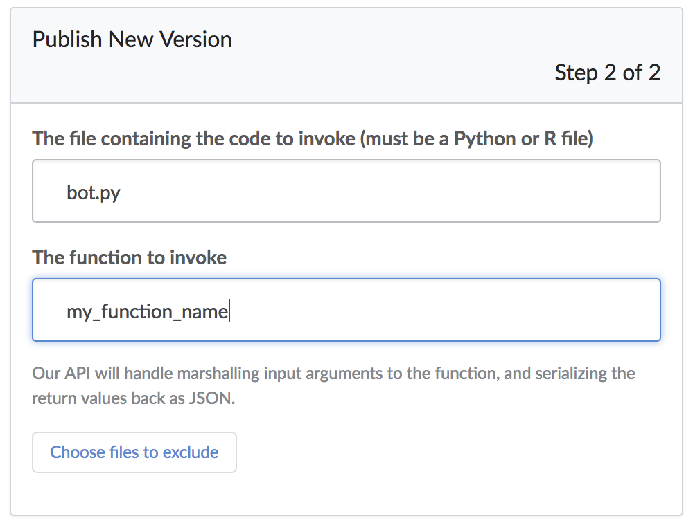
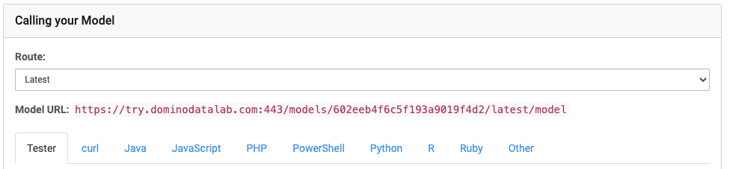
Build Model APIs in Domino
Script:
load model
function (input):
result = call model (input)
return result

Slide 38
Web Applications
Each Domino project can host one web app
Detailed instructions are available for Dash, Flask, Shiny, Streamlit, and Django in the documentation.
https://docs.dominodatalab.com

Slide 39
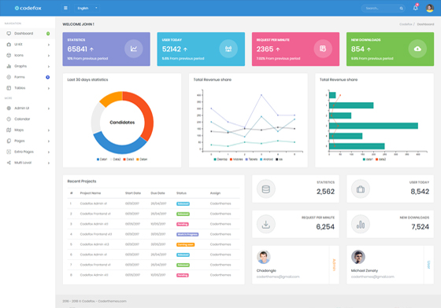


Web Applications in Domino
App Files
Start an app server
/mnt/…
app.sh

Slide 40
Web Applications Access
App Permission Levels
Anyone, including anonymous users
Users do not need a Domino account but must have network access.
Anyone with an account
All users with Domino accounts can view your App.
Invited users (other users may request access)
Logged-in Domino users can request access if the App appears in the Launchpad.
Invited users only
Only users added via the Invite People field can view the App; users cannot request access.

Slide 41
Deploy
Model
Wine Quality Workshop - Section 3

Slide 42
Deploy
Model
Wine Quality Workshop - Section 4

Slide 43
Wrap Up
Deploy
Model
What We Learned
How to deploy an Endpoint
How to run a quick test query
How to publish a web app
How to add input to an Endpoint
How to manage permissions
How to share apps
How This Helps You and Your Team
DSPs can easily self-serve Model APIs
Easily deploy two endpoints for A/B testing
DSPs can quickly create web apps
DSPs can easily share apps with business users
Preview apps before fully deploying

Slide 44
What Did We Learn Today?
Prepare
Project &
Data
Develop
Model
Deploy
Model
Created a Project
Prepare & Evaluate Model
Deploy & Collaborate
Set up project
Added collaborators
Defined project goals
Integrated data sources
Customized compute environment
Leveraged preferred IDEs
Ran and tracked experiments
Ran Jobs
Model API Web application
Shared and Collaborated
From ideation to deployment on a single centralized platform

Slide 45
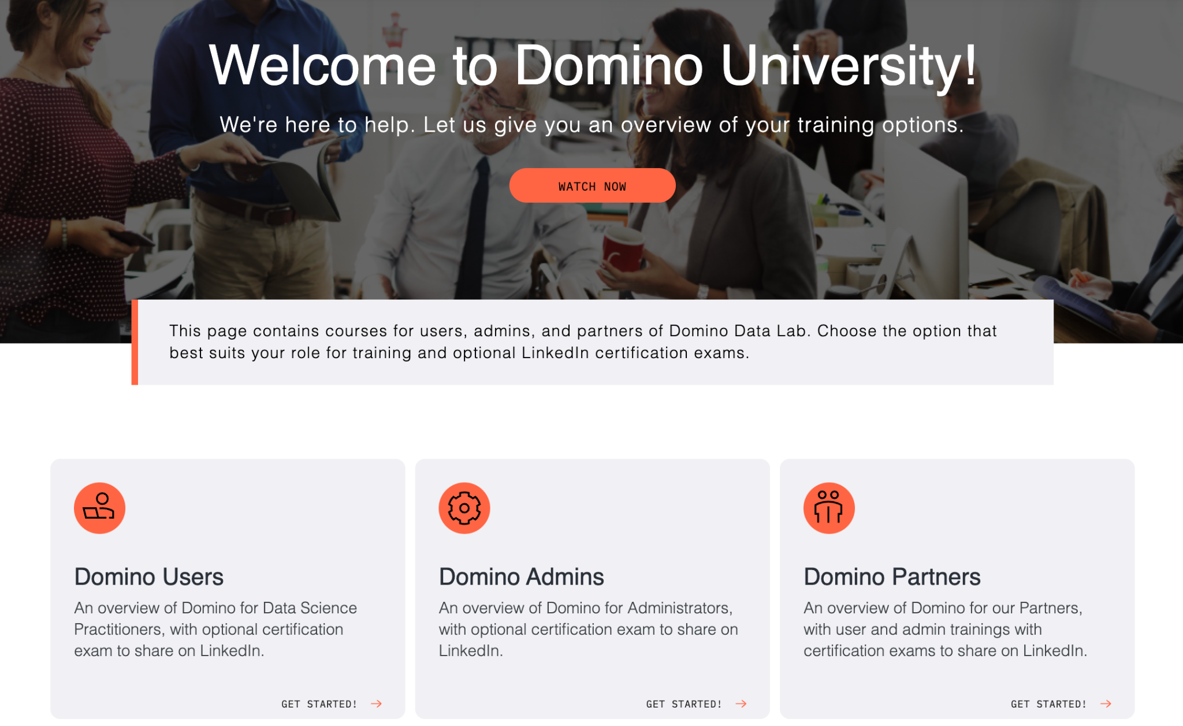
Domino University
Self-paced education content at Domino University provides a guided, deeper dive into everything Domino has to offer.
Access Domino University at https://university.domino.ai
Notes:
This will be a consistent theme: There’s a lot in Domino, and we can’t — and shouldn’t — cover everything today. In addition to our Docs site, you can head to Domino University.

